Slide 1
Student Habits and Studying Methods Dataset
Mauricio Monje
Sebastian Mejia
Aditya Dwivedi

Slide 2
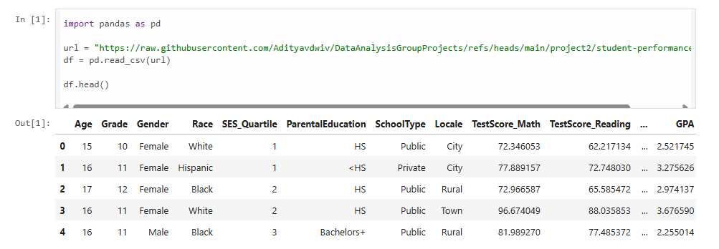
Dataset Overview
Data for 1000+ students academic records
21 Columns( features) such as GPA, AttendanceRate, StudyHours
Contain Both Numeric and Categorical data

Slide 3
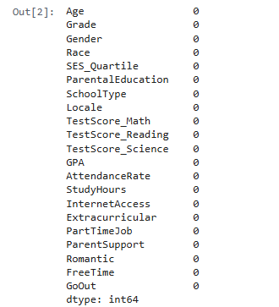
Data Cleaning
Normalized column names (lowercase, no extra spaces)
Removed duplicates
Checked for missing values
Ex.
df.columns = df.columns.str.lower().str.strip()
df = df.drop_duplicates()
df.isnull().sum()

Slide 4
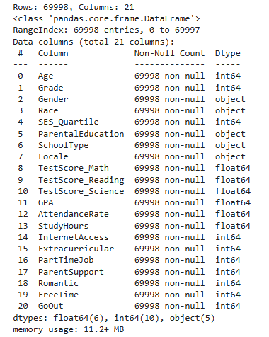
Placement & Connections
Removed duplicate rows
All columns have 69,998 non-null entries
No missing values detected
Mixed data types (int, float, object)

Slide 5
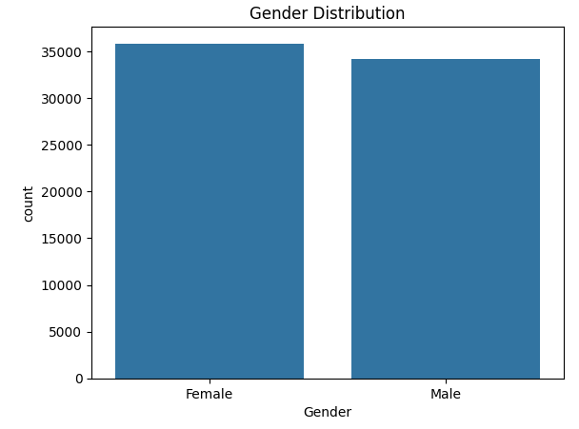
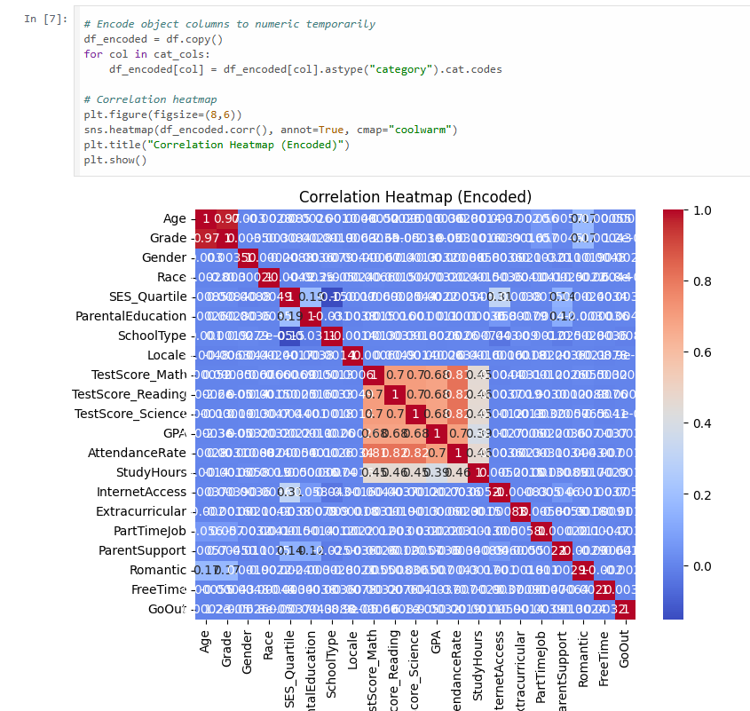
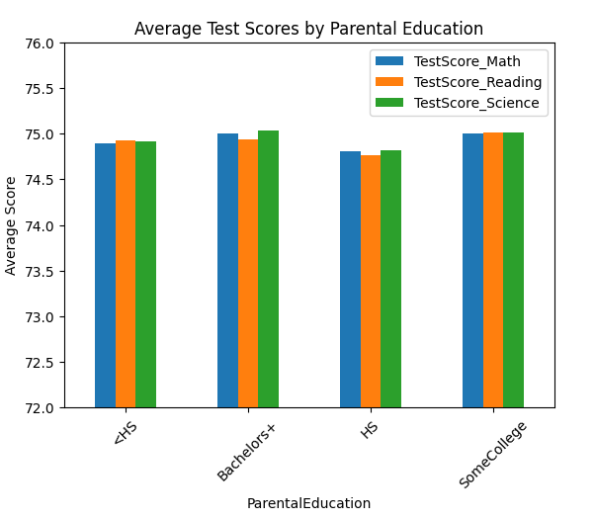
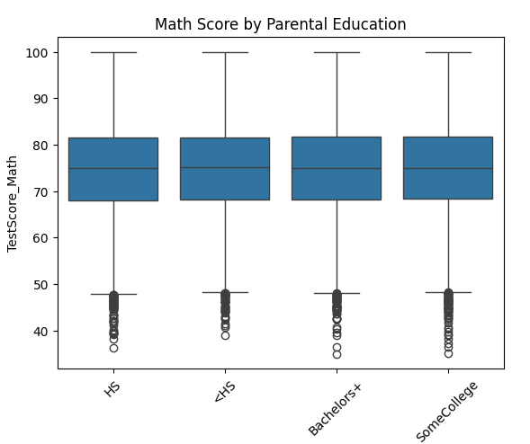
Visualisations

Slide 6
Data Preparation and Analysis
After the EDA, we cleaned and prepared the dataset by making categorical variables into a numeric format using one-hot encoding.
All numerical features using StandardScaler were scaled appropriately to ensure fair weight during modeling. This is highly useful for the models we’ll use like logistic and linear regression, which is highly sensitive to the scale of input data.
Without the scaling, we’ll see that some features may dominate over others, simply because they have larger numerical values.
For our project, GPA was selected as the target for our regression tasks, and for classification it was whether the student held a part-time job or not. We’re doing this to see key identifying factors that influence GPA the most.
In regression models, since GPA is a continuous variable, it helps estimate its value and reveal how much variance is explainable using student data. In other words, a high R² means the model is effective in capturing the underlying academic influences.

Slide 7

Feature Scaling and Train-Test Split
We separate the dataset into features (x) and target variable (y), where the target is GPA as mentioned before. This is to simulate how the model will perform on new and unseen data to evaluate its performance.
For our model, we did an 80% training sample and 20% test sample from our data set.
This will be used for, mostly, our Linear, Poisson, and Negative Binomial Regression.

Slide 8

Multiple Linear and Logistic Regression Models
First, we applied the Linear Regression portion to predict GPA. The model achieved an R² value of approximately 0.589, meaning it explained nearly 59% of the variation in GPA. The Root Mean Squared Error was around 0.294, meaning the model’s predictions typically different from actual value by about 0.29 GPA points.
The Logistic Regression classified whether student has a part-time job (Yes - 1 or No - 0), and, surprisingly, the model made perfect predictions on the test set, achieving and ROC AUC of 1.0, meaning something went wrong. The confusion matrix found no false positives or false negatives which means something is an issue, such as data leakage or an overly simple classification task where features strongly correlate with the target.

Slide 9
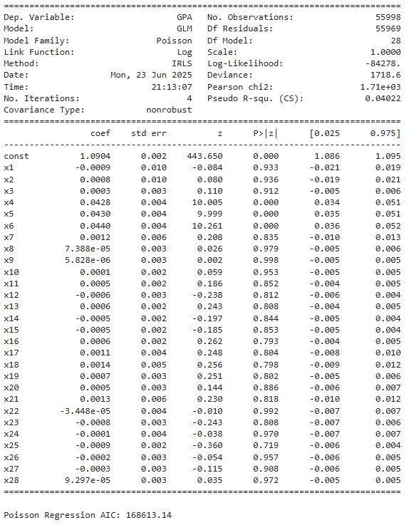
Poisson Regression
The Poisson Regression is a type of generalized linear model that is used for modeling count data. It assumes the target variable is a count and follows a Poisson distribution, where the variance is equal to mean.
In our case, we applied it to predict GPA, which resulted in the AIC being 168,613. AIC is a measure of how well the model fits the data while penalizing complexity. The lower it is, the better; in our case, we resulted in a very high count, making it a very poor fit for this type of model.
The explanation to why it performed so poorly is because GPA is not count data, it's a continuous variable that isn’t suited for the Poisson Regression. But, for the sake of testing, we wanted to see how it would perform with a variety of models.

Slide 10

KNN Regression
Finally, we tested a KNN regression model with K=5, which represents the 5 clost students based on all features and averages their GPA to predict a new student’s GPA.
As a result, we have achieved the following numbers:
R² = 0.438, this means that there was a 43.8% variability in GPA, performing much lower than the Linear Regression model.
MAE (Mean Absolute Error) = 0.276, on average, the model’s predictions are off by 0.276 GPA points.
RMSE (Root Mean Squared Error) = 0.344, RMSE is similar to MAE, but it punishes larger error made which is shown from the result.
From our results, the KNN model had lower R² and higher error than Linear Regression. Not the best, but also not the worst and did fairly reasonable.

Slide 11
Advanced Models & Model Comparison
Built 2 models.
Support Vector Machine (SVM)
Decision Tree
Added an ensemble model:
Random Forest
Compared all models
Encountered challenges with model training taking 30 minutes to complete.

Slide 12
Support Vector Machine (SVM)
Why SVM?
Good for both linear and non-linear relationships
Works well with high-dimensional data
Initial Challenge:
First tried RBF kernel with default parameters
Training time exceeded 30 minutes
Needed to optimize for both performance and speed
Results weren’t great:
R² = -0.392 (worse than horizontal line)
MAE = 0.434 (high error)
RMSE = 0.541 (largest error spread)

Slide 13
Decision Tree
Why Decision Tree?
Easy to understand and interpret
Can handle both numerical and categorical data
No assumptions about data distribution
Results:
R² = 0.112 (explains only 11.2% of variance)
MAE = 0.345 (high average error)
RMSE = 0.432 (large error spread)

Slide 14
Random Forest (Ensemble)
Why Random Forest?
Combines multiple decision trees
Reduces overfitting through averaging
Handles feature importance well
Good results:
R² = 0.579 (explains 57.9% of variance)
MAE = 0.239 (low average error)
RMSE = 0.297 (best error spread)

Slide 15
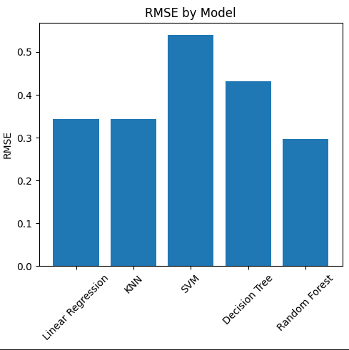
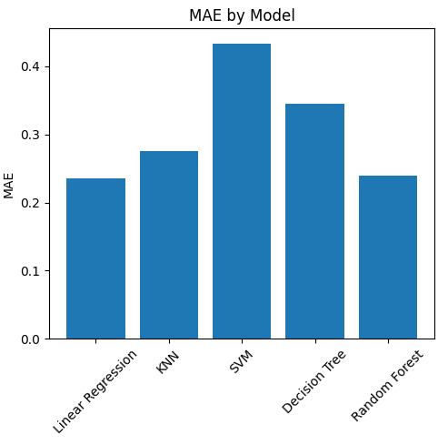
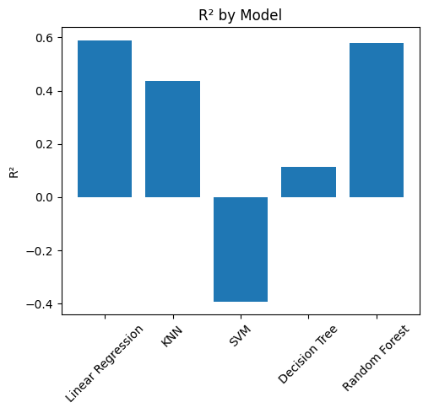
Model Comparison
1. Linear Regression
Best R² (0.589)
Best MAE (0.235)
RMSE: 0.344
2. Random Forest (Close Second)
Similar R² (0.579)
Good MAE (0.239)
Best RMSE (0.297)
3. KNN
Decent R² (0.438)
Good MAE (0.276)
RMSE: 0.344

Slide 16
What We Learned
Model Complexity vs Performance
Simpler models can outperform complex ones
Linear Regression matched Random Forest
Complex models need careful tuning
Power of Ensemble Methods
Random Forest: R² improved from 0.112 to 0.579
Combining weak learners created strong predictor
Reduced overfitting while maintaining flexibility

Slide 17
Thank You!

